Slide 1
Bachelor Life Hack

Slide 2
Goals
The main goal is to provide a platform for students and job holders where they can get easy access to buy and sell used products.
We can save data about product, buyer, payment , commission and transportation of product.

Slide 3
Entity List
Product
Bachelor_Buyer
Commercial_Buyer
Payment
Commission
Product_Transport

Slide 4
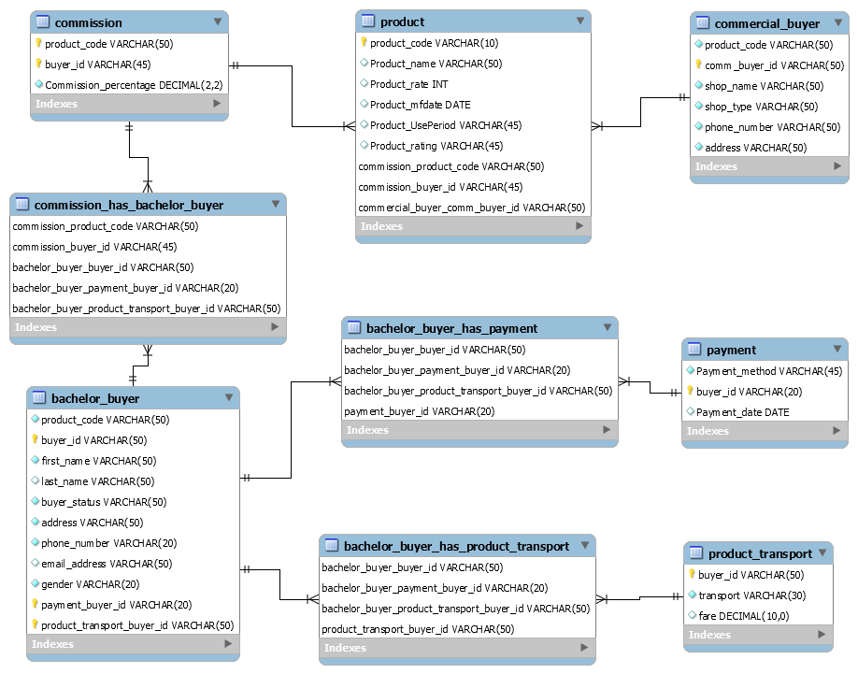
ER Diagram

Slide 5
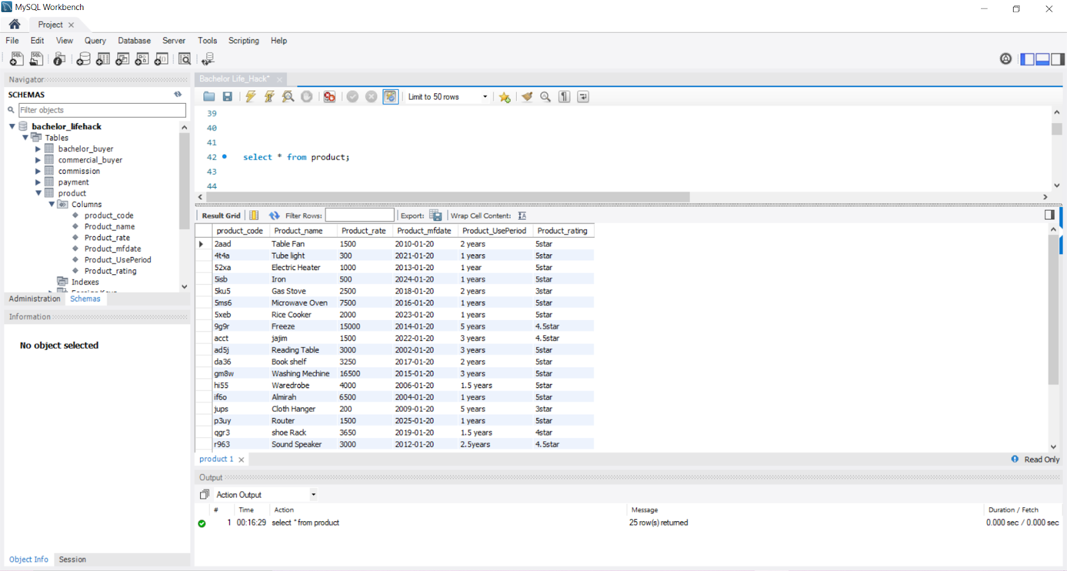
Query
select * from product;

Slide 6
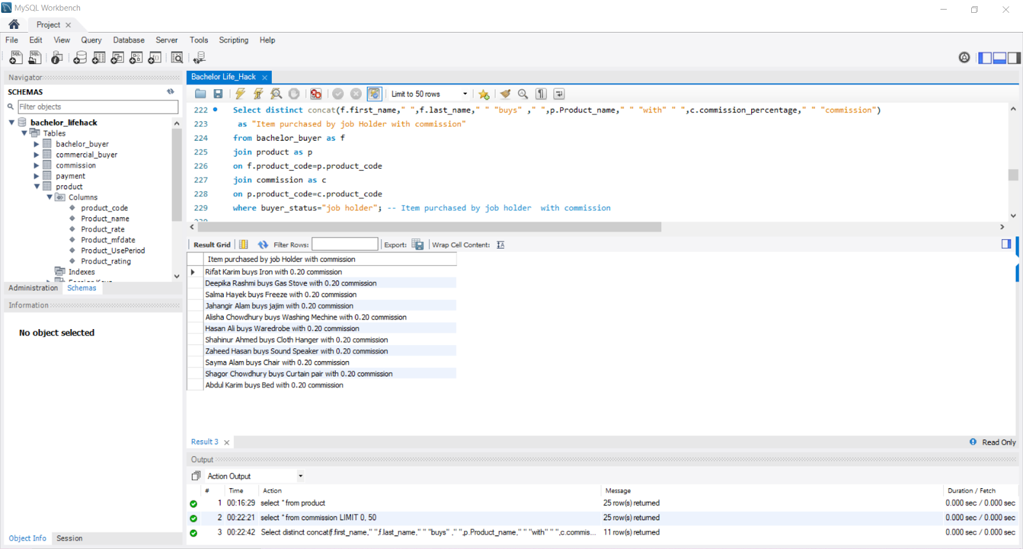
Items purchased by job holder with commission
Select distinct concat(f.first_name,"",f.last_name," " "buys" ," ",p.Product_name," " "with" " ",c.commission_percentage," " "commission")as "Item purchased by job Holder with commission"
from bachelor_buyer as f
join product as p
on f.product_code=p.product_code
join commission as c
on p.product_code=c.product_code
where buyer_status="job holder";

Slide 7
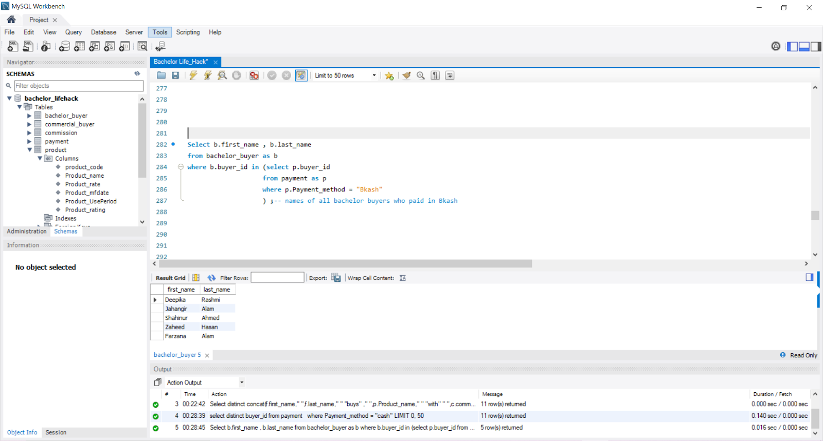
Names of all bachelor buyers who paid in Bkash
Select b.first_name , b.last_name
from bachelor_buyer as b
where b.buyer_id in (select p.buyer_id
from payment as p
where p.Payment_method = "Bkash"
) ;-- names of all bachelor buyers who paid in Bkash

Slide 8
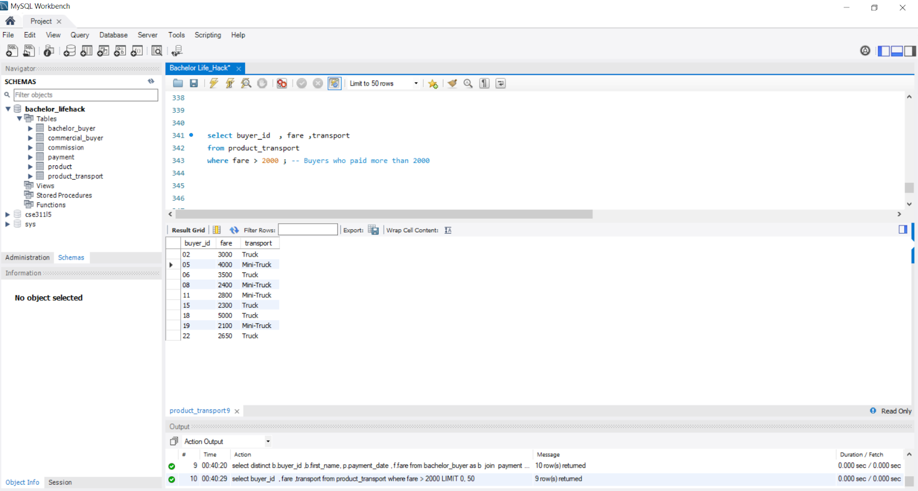
Buyers who paid more than 2000​
select buyer_id , fare ,transport
from product_transport
where fare > 2000 ;

Slide 9
Conclusion
We think that our project has all the features that are required for providing an easy life for bachelors.

Slide 10
Thank You For Your Patience

